Slide 1
Simplifying JSP Development with Expression Language

Slide 2

Module Overview
EL Fundamentals
Basic Operators Implicit Objects
Demo: Simplifying JSP Development with Expression Language

Slide 3
EL Fundamentals

Slide 6
Introduced from JSP 2.0
Accessing data from a
Expression Language Fundamentals
JavaBean,Request,Response,Session,Applic ation
*, +, - , () , [ ] and < or It, > or gt , ! or not Null Friendly Language

Slide 7
$ { expression }
Syntax
Expression Language

Slide 8
More information using simple expression
Easy to access or modify Bean Properties Access Nested Property
EL Advantages
Collection Elements
Provides Math and Conditional Operators Supports Automatic Type Conversions

Slide 9
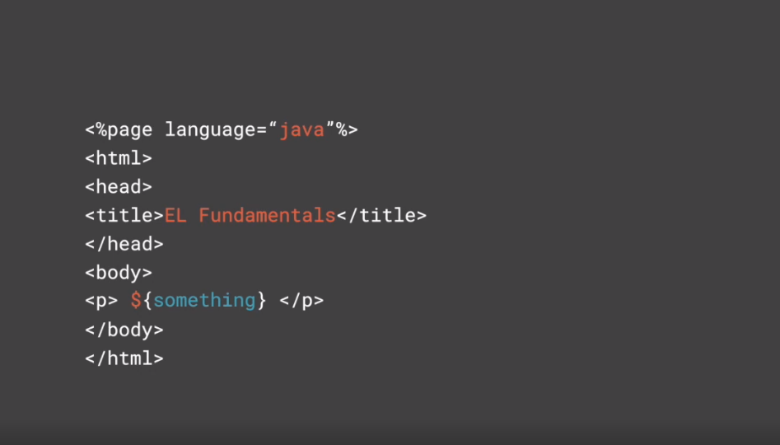

Slide 10
<jsp:config>
<el-ignored> true | false </el-ignored>
</ jsp:config>
Syntax
Deployment Descriptor Element

Slide 11
<jsp:config>
<%@page isELIgnored="true | false" %>
</ jsp:config>
Syntax
With in Directive

Slide 12
Basic Operators

Slide 13
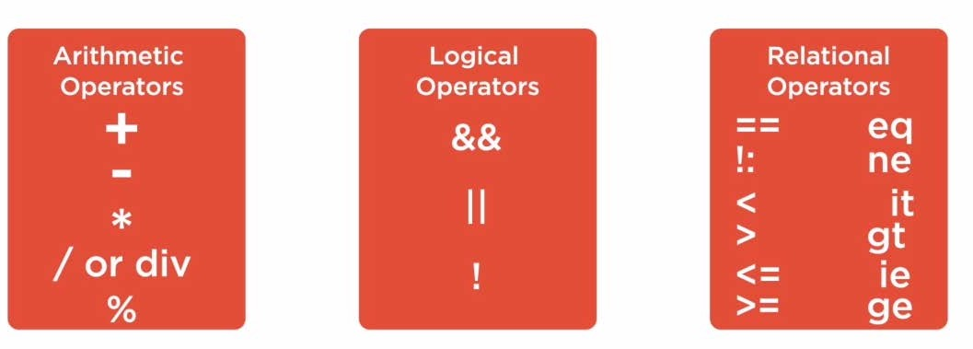

Basic Operators
Reserved words such as true,false,null,empty

Slide 15
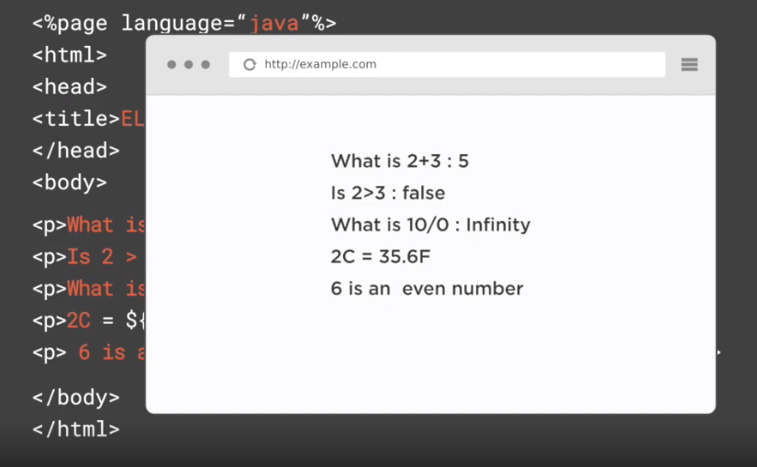

Slide 16
Implicit Objects

Slide 17
pageContext Object
${ pageContext.request.queryString}
header object
$[header["user-agent"]
headerValue scope object pageScope
requestScope sessionScope applicationScope
param paramValues initParam
cookie
EL-Implicit Objects

Slide 18
${course.courseName}
${requestScope.course.courseName}
Syntax
To access the Java Bean property

Slide 19



Slide 20

Assisted Practice
Simplifying JSP Development with Expression Language

Slide 21
EL Fundamentals
Basic Operators Implicit Objects
Summary
Simplifying JSP Development with Expression Language

